Slide 1
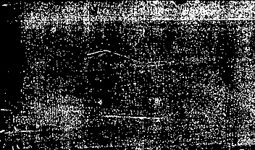
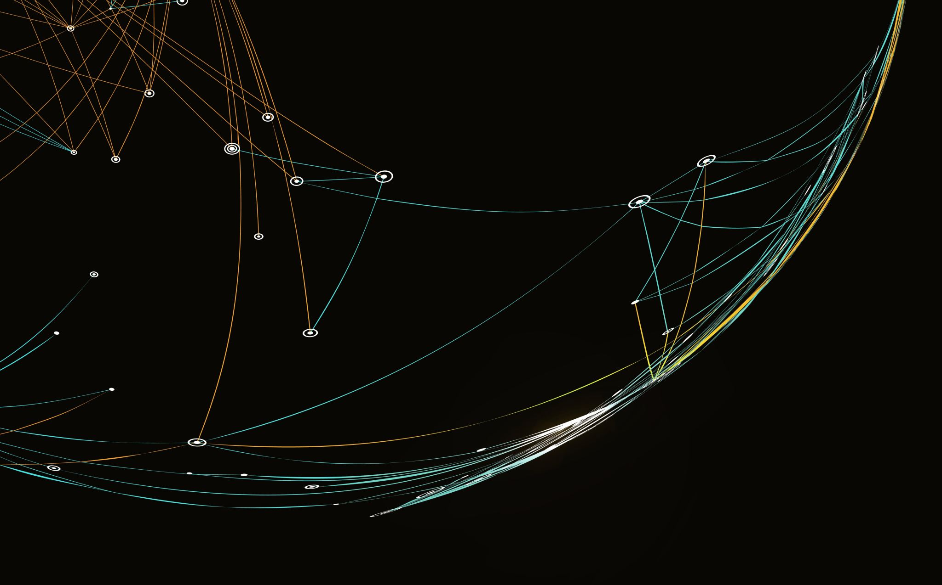

Feature Matching

Slide 2

Feature Detection & Matching
Important task in many computer vision applications
Structure-from-motion
Image retrieval
Object detection

Slide 3

Applications of Feature Detection & Matching
Automate object tracking
Point matching for computing disparity
Stereo calibration (Estimation of the fundamental matrix)
Motion-based segmentation
Recognition
3D object reconstruction
Robot navigation
Image retrieval and indexing

Slide 4

Features
A piece of information relevant for solving the computational task related to a certain application
Specific structures in the image
Points
Edges
Objects
The result of a general neighborhood operation or feature detection applied to the image

Slide 5

Features Classification
Keypoint Features
Specific locations of the images
Often described by the appearance of patches of pixels surrounding the point location
Edges
Can be matched based on their orientation and local appearance
Good indicators of object boundaries and occlusion events in the image sequence.

Slide 6

Steps of Feature Detection And Matching
Detection:
1
Identify the Interest Point
Description:
2
The local appearance around each feature point is described in some way that is (ideally) invariant under changes in illumination, translation, scale, and in-plane rotation
A descriptor vector for each feature point.
Matching:
3
Descriptors are compared across the images, to identify similar features

Slide 7

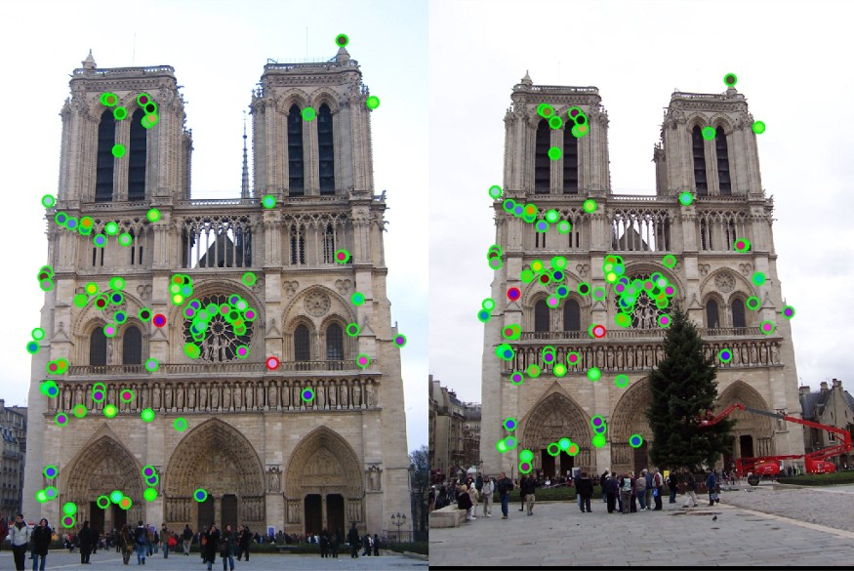
Interest Point/Feature Point
The point which is expressive in texture
The point at which the direction of the boundary of the object changes abruptly
Intersection point between two or more edge segments.
Based on the brightness of an image(Usually by image derivative).
Based on Boundary extraction(Usually by Edge detection and Curvature analysis).

Slide 8

Properties Of Interest Point
Well-defined position in image space or well localized
Stable under local and global perturbations in the image domain as illumination/brightness variations => interest points can be reliably computed with a high degree of repeatability
Should provide efficient detection

Slide 9

Algorithms for Identification
Harris Corner
SIFT(Scale Invariant Feature Transform)
SURF(Speeded Up Robust Feature)
FAST(Features from Accelerated Segment Test)
ORB(Oriented FAST and Rotated BRIEF)

Slide 10

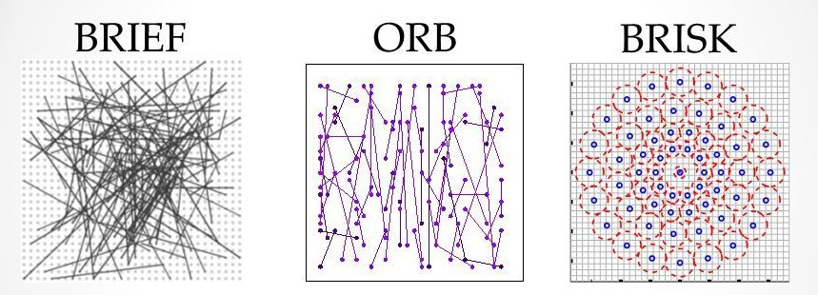
Feature Descriptor
An algorithm which takes an image and outputs feature descriptors/feature vectors
Sort of numerical “fingerprint” that can be used to differentiate one feature from another
Ideally: invariant under image transformation
One descriptor for each feature point

Slide 11

Feature Descriptors Classification
Local Descriptor
A point’s local neighborhood.
Resemble shape and appearance only in a local neighborhood around a point
Very suitable for representing a point in terms of matching
Global Descriptor
Describes the whole image
Not very robust as a change in part of the image may cause it to fail (it will affect the resulting descriptor)

Slide 12

Algorithms
SIFT
SIFT(Scale Invariant Feature Transform)
SURF
SURF(Speeded Up Robust Feature)
BRISK
BRISK (Binary Robust Invariant Scalable Keypoints)
BRIEF
BRIEF (Binary Robust Independent Elementary Features)
ORB
ORB(Oriented FAST and Rotated BRIEF)

Slide 13

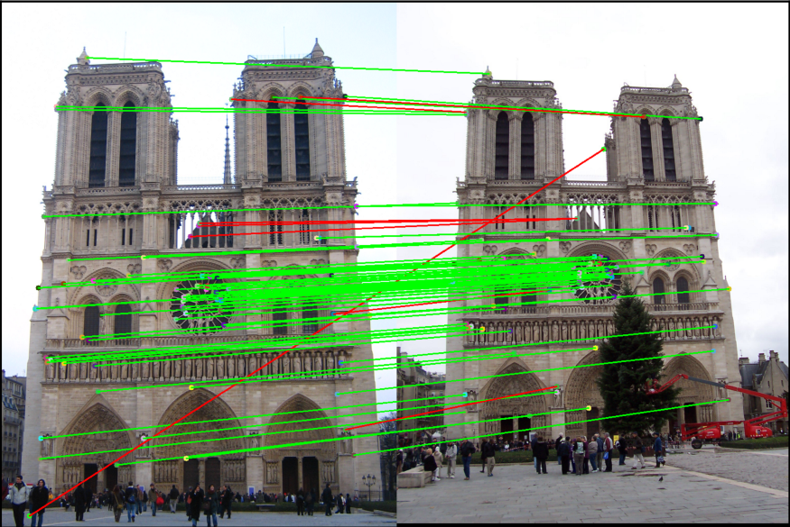
Features Matching
A part of many computer vision applications
The task of establishing correspondences between two images of the same scene/object
The performance of matching methods based on interest points depends on both the properties of the underlying interest points and the choice of associated image descriptors
Detectors and descriptors appropriate for images contents shall be used in applications

Slide 14

Features Matching. Algorithms
Brute-Force Matcher
FLANN(Fast Library for Approximate Nearest Neighbors) Matcher

Slide 15

Algorithm for Feature Detection & Matching
Find
Find a set of distinctive keypoints
Define
Define a region around each keypoint
Extract and normalize
Extract and normalize the region content
Compute
Compute a local descriptor from the normalized region
Match
Match local descriptors

